Slide 1
Chemical Pollution of Freshwater ~ a multi-faceted (societal) challenge
Rob Collins, Anneka France and Josh Jones
The Rivers Trust
rob.collins@theriverstrust.org

Slide 2
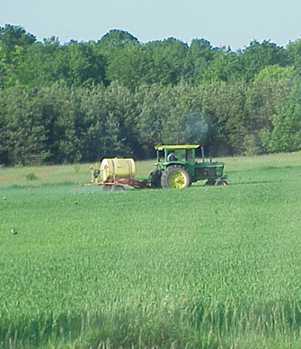
Chemicals are ubiquitous in the environment
Annual production of hazardous chemicals across Europe is c. 200 million tons
Released to the environment including water at all stages of their lifecycle
Emission/Discharge to freshwater via several diffuse and point source pathways

Slide 3
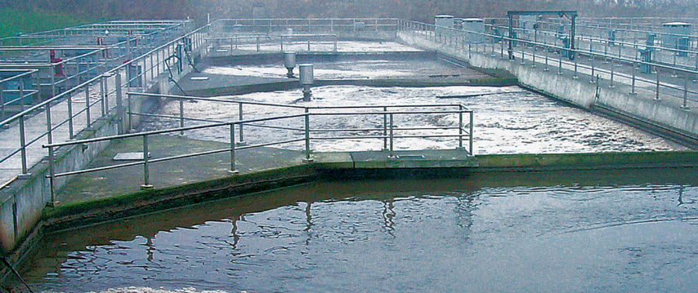
Via Municipal Wastewater Treatment Plants
Many industrial chemicals, together with those used in the home (pharmaceuticals, cosmetics,
personal care and cleaning products), are discharged to wastewater treatment plants and subsequently
released to the aquatic environment in partially treated effluent

Slide 4
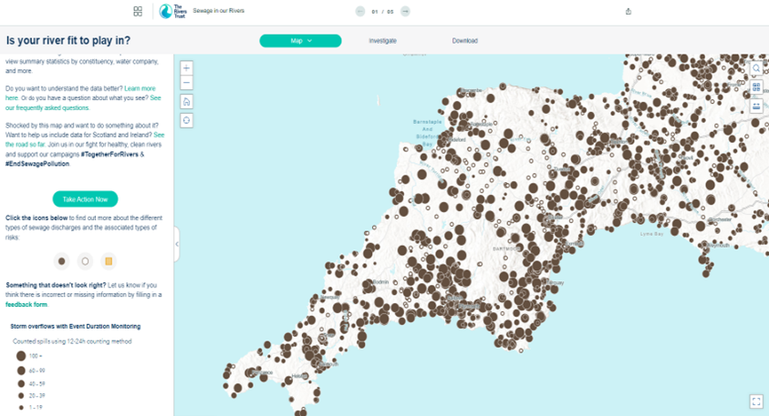
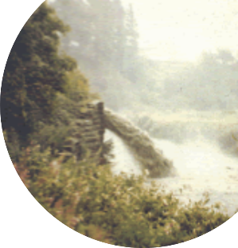
Storm Overflows
c. 350,000 storm overflows per year.
For a duration of 2 million hours
https://theriverstrust.org/sewage-map
Notes:
There are currently more than 16,000 sewer storm overflows in England, combining raw sewage with rainfall runoff from impermeable urban surfaces.

Slide 5
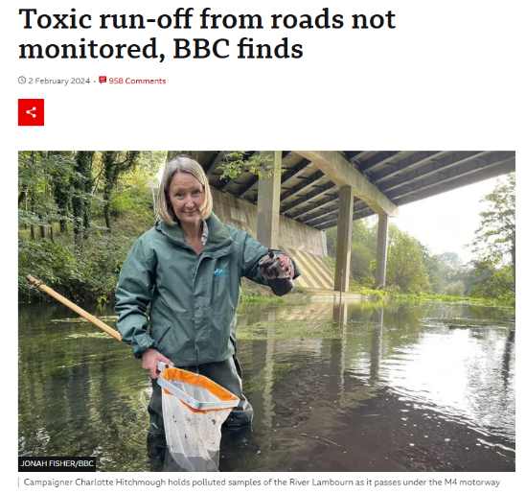
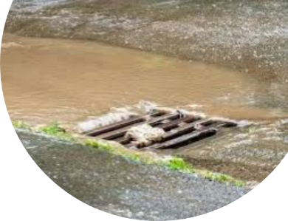
Urban and Road Runoff
Toxic pollutants such as metals and hydrocarbons washed directly into rivers

Slide 6
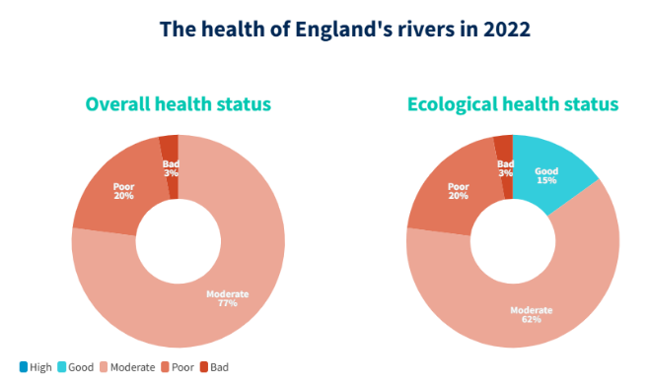
Not a single English river is at ‘good’ chemical status
Classification is based on just 45 chemicals
Yet, we can find hundreds in rivers, lakes, groundwater and coastal waters

Slide 7
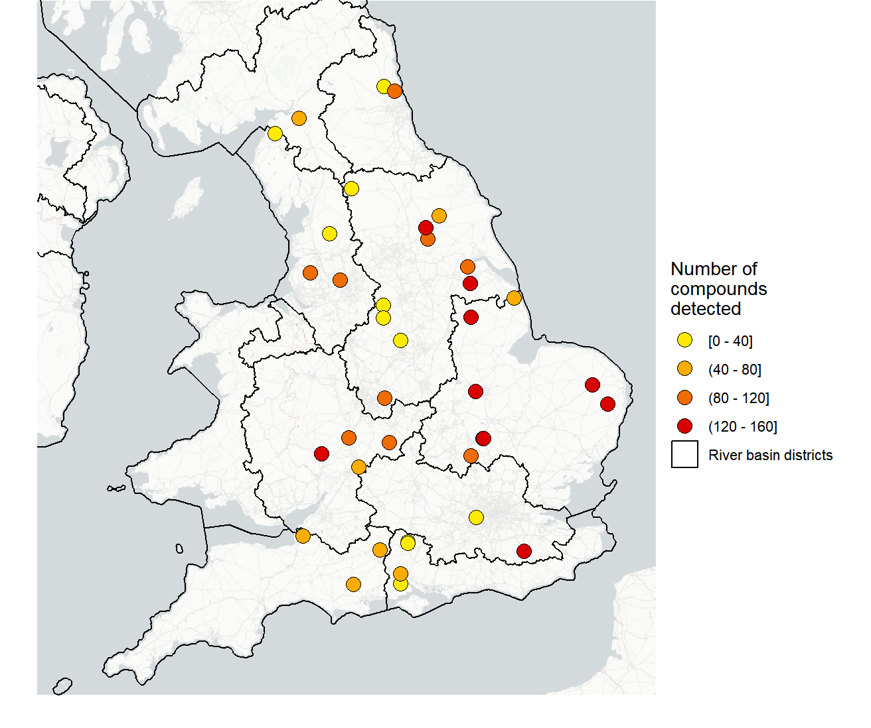
Chemical Mixtures - I
Tens to hundreds of chemicals at each EA river monitoring site (2022)
Pet parasiticides (flea, tick treatments) e.g., fipronil 83% detection
Fungicides, e.g., azoxystrobin 81% detection. Up to 9 different fungicides in the same sample
Insect repellent, picaridin (81% detection)
Antibiotics, e.g., clarithromycin (67% detection)

Slide 8
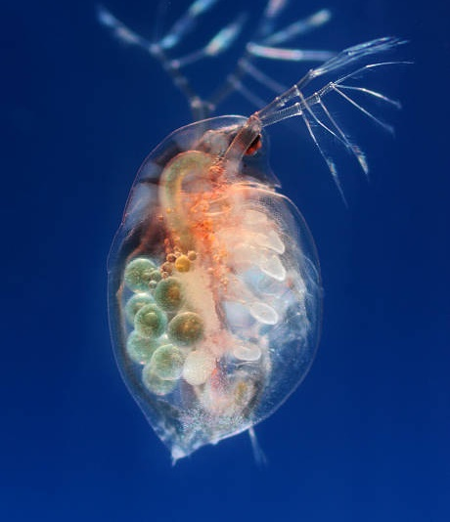
Impacts upon Aquatic Biota
Lab and field studies show a range of acute and chronic effects upon several species
Adverse effects on growth, reproduction and behaviour
Adverse synergistic or additive effects of chemical mixtures

Slide 9
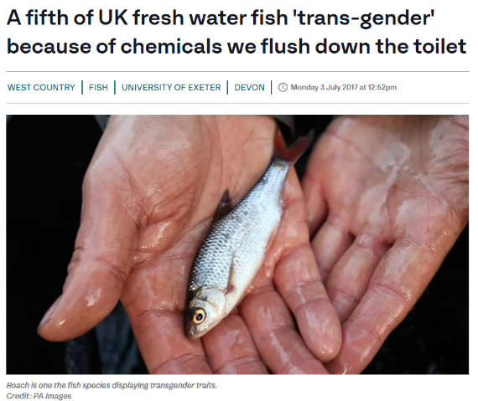
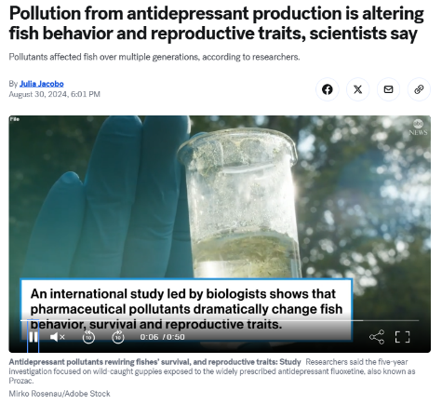
Impacts upon Aquatic Biota

Slide 10
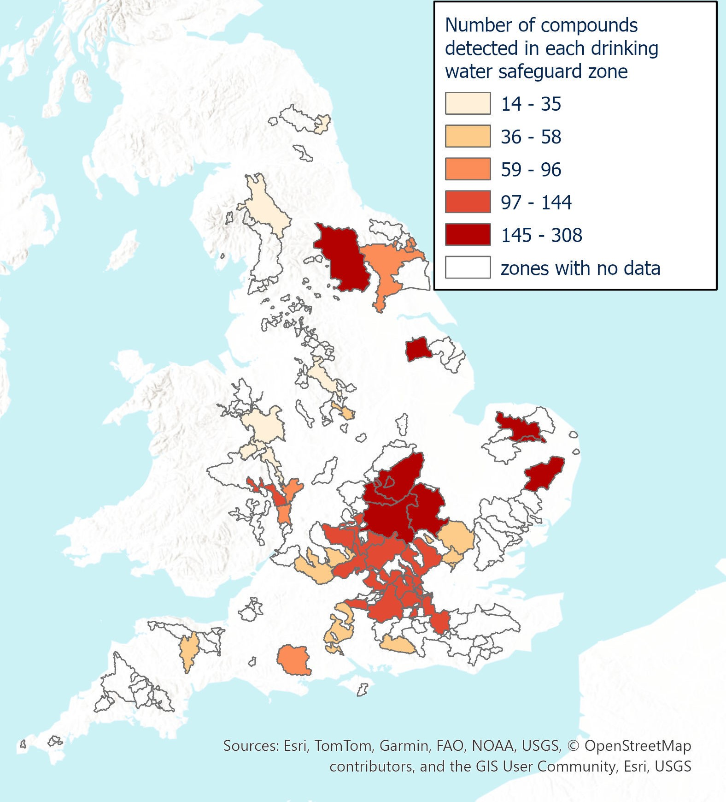
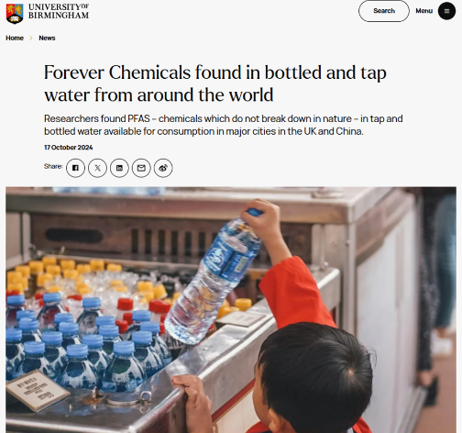
Human Health: Exposure via Drinking Water
Exposure to very low trace levels of chemicals
Health implications of ingestion over decades?

Slide 11
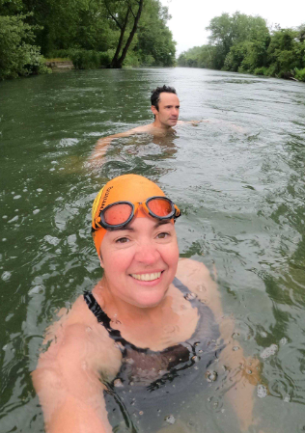
Human Health: Exposure via fresh and coastal water recreation
Cocktail of chemicals
Antimicrobial resistance a growing concern
Surfers three times more likely to carry drug-resistant bacteria than non-surfers (University of Exeter)

Slide 12
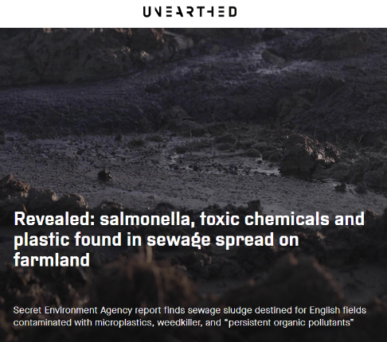
Human (and Ecosystem) Health: Sewage sludge applied to land
Industrial chemicals, pharmaceuticals, pathogens, microplastics
Between 31,000 and 42,000 tonnes of microplastics, incorporating several chemical additives, are spread on European farmland soils each year within sewage sludge

Slide 13
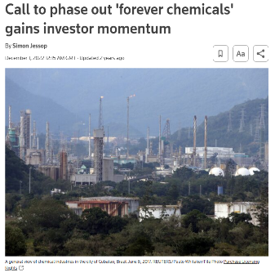
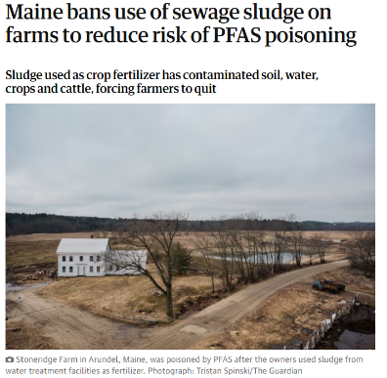
Per- and Polyfluoroalkyl Substances (PFAS)
Can persist in the environment for 1,000 years, hence ‘forever chemicals’
Thousands of different PFAS
Range of human health risks – reproduction, developmental, carcinogenic, hormonal
Growing recognition of threat to humans and wildlife

Slide 14
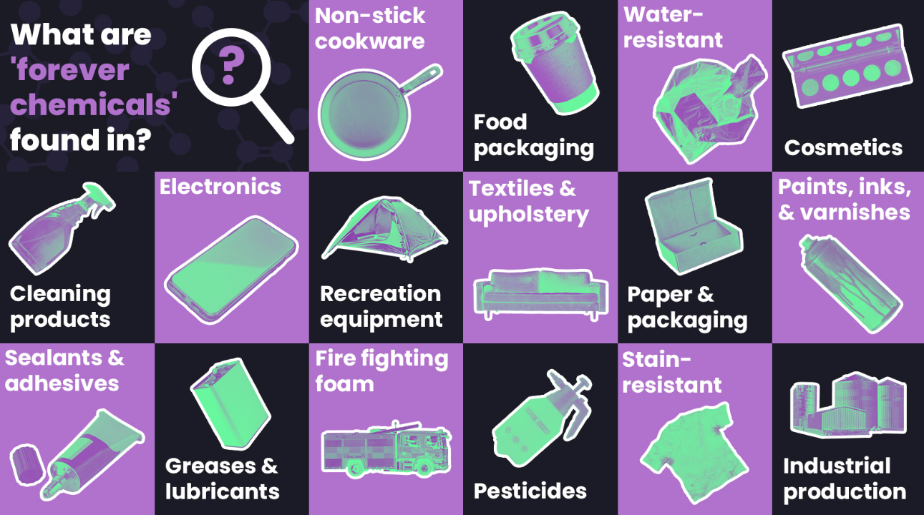
Notes:
https://www.ncbi.nlm.nih.gov/pmc/articles/PMC7784712/

Slide 15
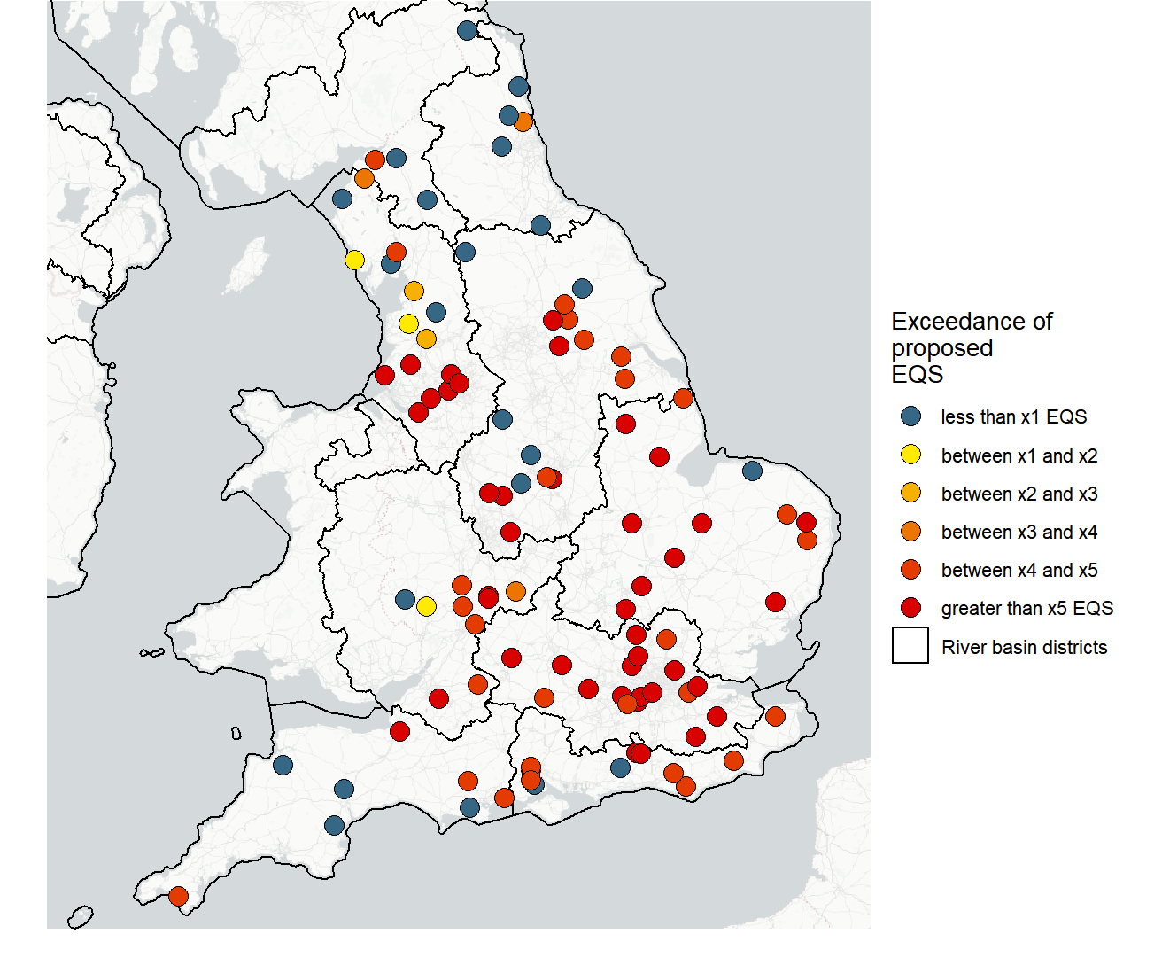
PFAS in English Rivers
Comparison against proposed new EU standard
Evaluates 24 different PFAS with Relative Potency Factors
81 of 105 sites exceed new standard
44 sites greater than X5; some exceedance X10-20
Best Case Approach (its worse in reality)
https://www.wcl.org.uk/uk-falling-behind-in-fight-against-toxic-forever-chemicals.asp

Slide 16
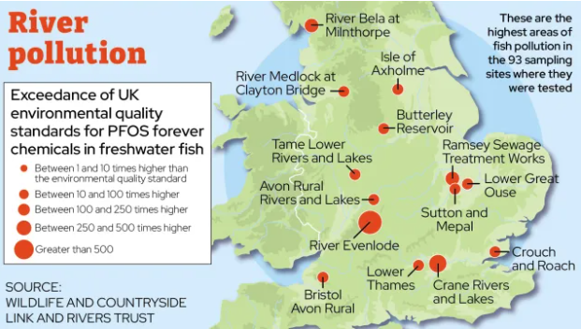
PFAS in Fish
On average, 300 times greater than proposed EQS for biota
Increase in blood serum estimated based on different rates of fish consumption (Barbo et al., 2023)
Monthly consumption exceeds European Food Safety Authority threshold
Not typically fish we would eat, but wider implications
Image: inews

Slide 17
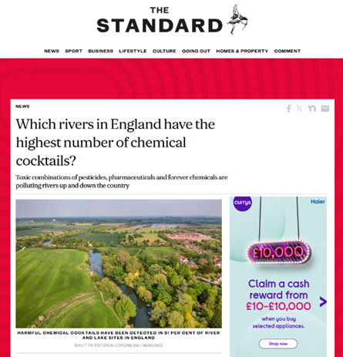
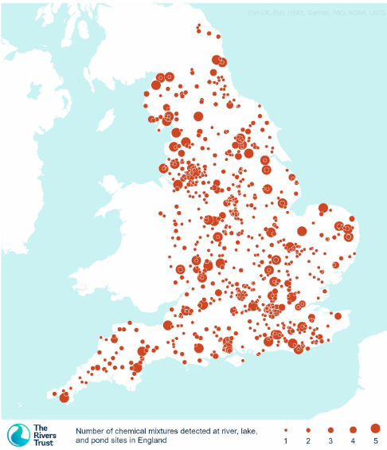
Chemical Mixtures - II
Explored combinations of 6 chemicals in 5 different mixtures known to have adverse effects
PFOS, PFOA, PFBS and PFHxS, the pesticide 2,4-D, and ibuprofen
At least 1 of the 5 mixture combinations found in 81% of rivers
54% had 3 or more of the 5 mixtures
https://www.wcl.org.uk/toxic-chemical-cocktails-in-rivers-across-england.asp

Slide 18
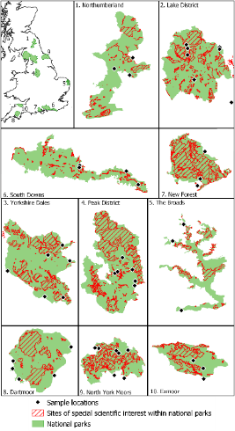
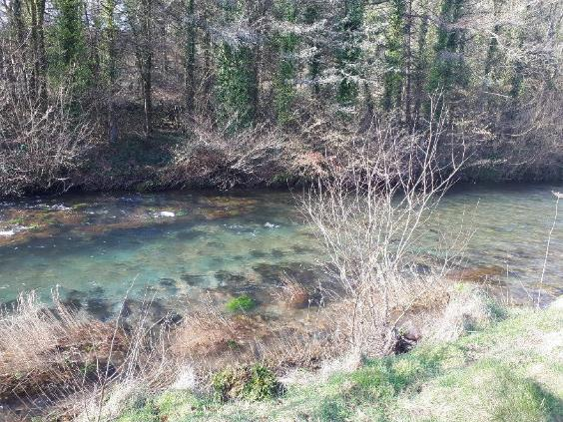
Pharmaceuticals in English National Park Rivers
Collaboration with York University; https://setac.onlinelibrary.wiley.com/doi/10.1002/etc.5973

Slide 19
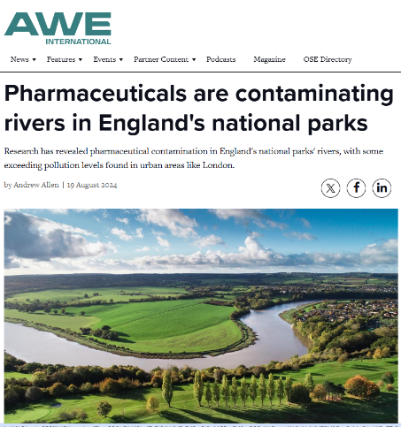
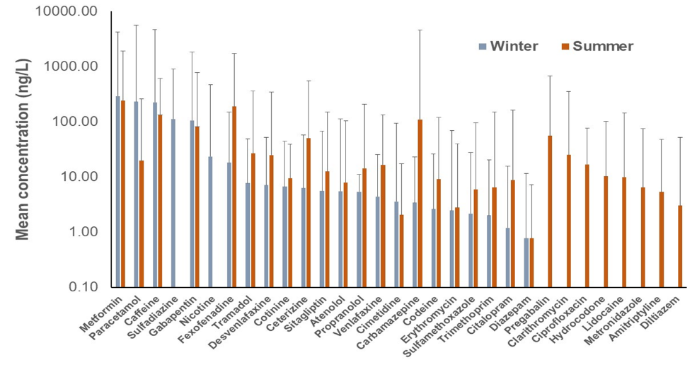
Numerous Pharmaceuticals Detected

Slide 20
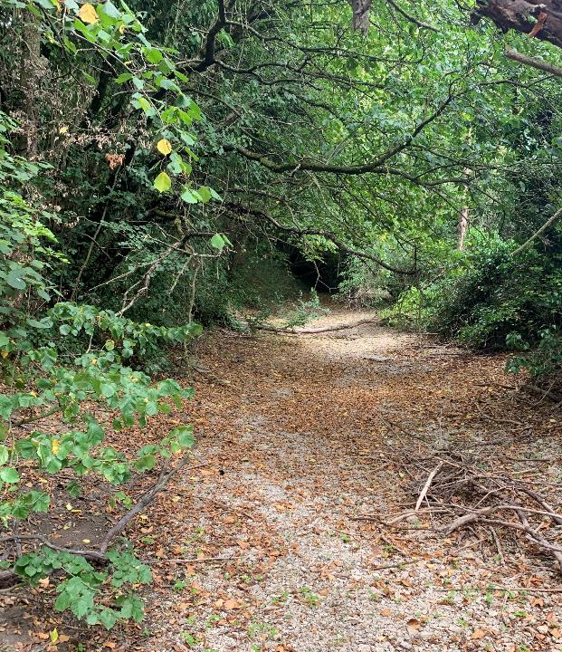
Unfortunately, droughts in the UK are predicted to increase in severity and frequency
Dilution of Pollution

Slide 21
Addressing the Chemical Pollution of our Aquatic Environments
Multifaceted solutions that encompass wider society

Slide 22
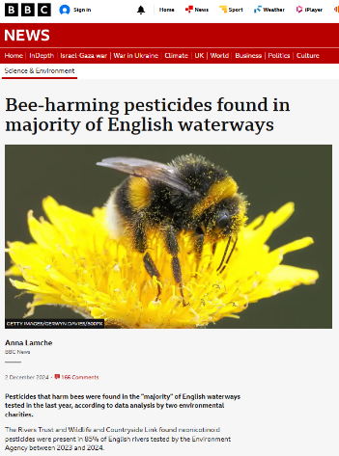
Control at Source is Critical
Ban the most toxic, find less harmful substitutes

Slide 23
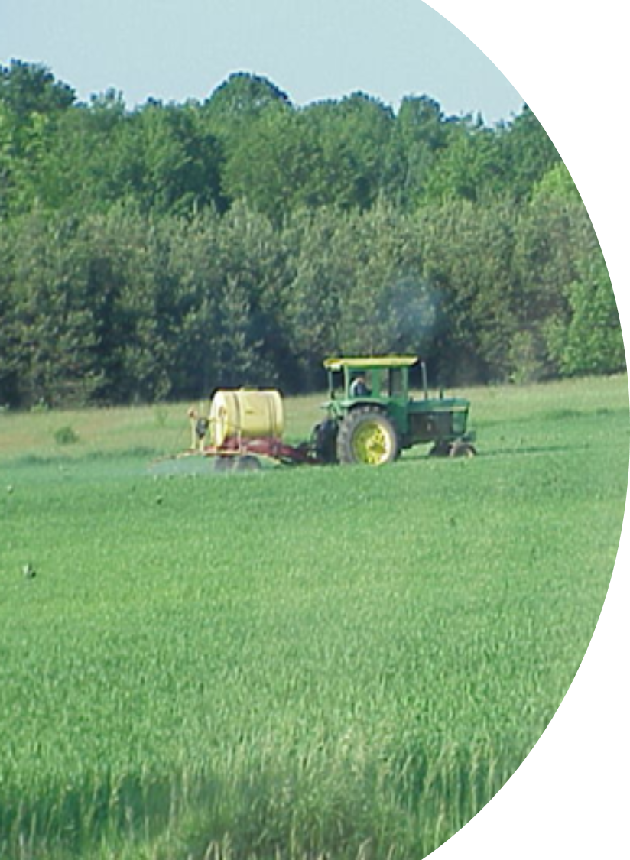
Advice and Support to Farmers
National Action Plan for Pesticides
https://www.gov.uk/government/publications/uk-pesticides-national-action-plan-2025/uk-pesticides-national-action-plan-2025-working-for-a-more-sustainable-future
Objectives will only be met through support to farmers
Improved timing and locality of pesticide applications
More sustainable use is good for farm business and aquatic environment

Slide 24
Address UK and EU Chemicals Divergence
UK and EU REACH (Authorisation & Regulation of Chemicals)
EU REACH has banned 36 pesticides (13 hazardous)
https://www.pan-uk.org/post-brexit-pesticide-divergence/
EU Restriction proposal on PFAS (Bans in DK & FR)
Updated Directive to address wastewater treatment with improved monitoring of emerging contaminants and Pharmaceutical & Cosmetic industries to pay
New Urban Wastewater Treatment Directive

Slide 25
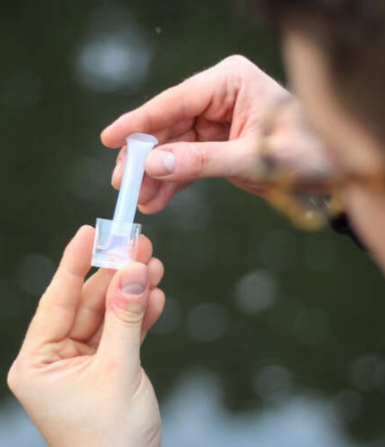
Improved Monitoring
Legislation only addresses 45 out of thousands of chemicals. No regulatory driver to address the rest
Lack of monitoring during high flow
Little focus on contaminants in sediment
Quantification of emissions by source is poor, and limits cost-effective action
Improved Monitoring

Slide 26
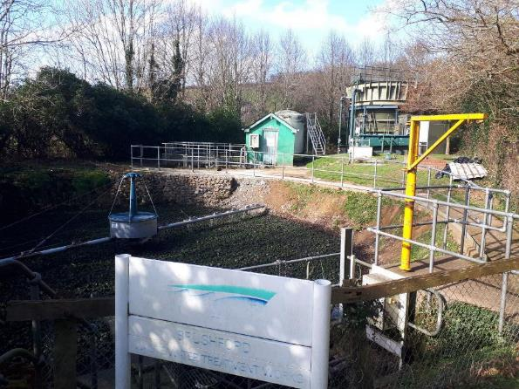
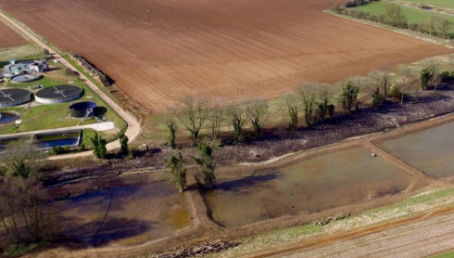
Investment into Wastewater Treatment ~including storm overflows
Nature Based Solutions can play a role

Slide 27
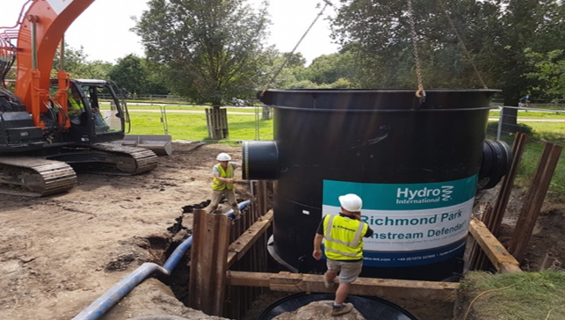
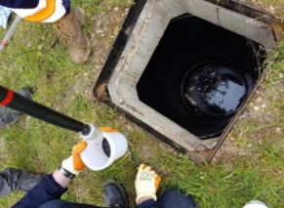
Hydrodynamic chamber – traps particulate urban runoff - metals, hydrocarbons
Innovative Solutions
Photos:South East Rivers Trust

Slide 28
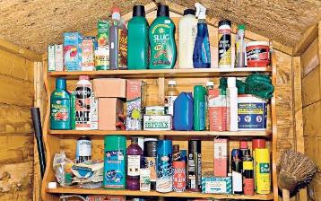
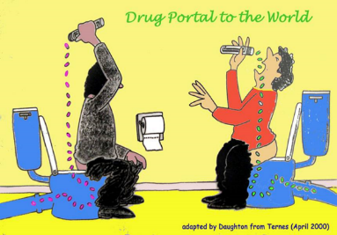
Raising Public Awareness
More sustainable use and disposal of household and garden chemicals
< 15% of public aware of medicine take-back schemes
Unopened, unused and out-of-date medicines, can be taken to the local pharmacy, rather than flushed down the toilet and into the sewer system

Slide 29
Thanks
With thanks to the

